Slide 1
Algorithm & Programming
Subject : COMP6047
ALGORITHM AND PROGRAMMING
Year : 2019

Slide 2
Learning Outcomes
LO-1 : Explain About algorithm and its representation

Slide 3
Outline
Algorithm definition
Flowchart
Pseudocode
Algorithm definition
Flowchart
Pseudocode

Slide 4
Algorithm Definition
Algorithm is a procedure for solving a problem in terms of the actions to be executed, and the order in which these actions are to be executed
We have a sequential list of actions from start/initial state to goal
We have input, we have output.
You will have to design and structure these list of actions.
Derived from the word algoris and ritmis. Introduced by Al-Khowarizmi.
In the programming domain, algorithm define as method that consist of structured steps in problem solving using computer.

Slide 5
Simple Algorithm Example
Rise and Shine Algorithm
Set actions
Sequential order of actions
Get out of bed
Take off pajamas
Take a shower
Get dressed
Eat breakfast
Carpool to work

Slide 6
Algorithm Development Steps
PROBLEM
PROCESS
SOLUTION
Algorithm
Source Code
Executable Code
Problem Definition
Model Development
Algorithm Design
Writing Code
COMPILE
Debugging process
Syntax Err
Executable code: => Run
Output Err
Debugging process
Documentation

Slide 7
Algorithm Development Steps
Problem Definition
Model Development
Algorithm Design
Writing Code
COMPILE
Problem:
Finding the solution or root of quadratic equation
Definition:
Quadratic equation : ax^2 + bx + c = 0
Data needed:
Coefficient of a, b and c : real type
Syntax Err
Executable code: => Run
Output Err
Documentation

Slide 8
Algorithm Development Steps
Problem Definition
Model Development
Algorithm Design
Writing Code
COMPILE
Syntax Err
Mathematical model:
Quadratic formula:
x1 = (-b + sqrt(b^2 - 4ac))/2a
x2 = (-b – sqrt(b^2 - 4ac))/2a
Executable code: => Run
Output Err
Documentation

Slide 9
Algorithm Development Steps
Problem Definition
Model Development
Algorithm Design
Writing Code
Start
COMPILE
Input a,b,c
Syntax Err
d = b^2 – 4ac
Executable code: => Run
d < 0
Y
N
Output Err
x1=(-b+sqrt(d))/2a
x2 =(-b-sqrt(d))/2a
Print:
“Imaginary”
Documentation
Print : x1, x2
Stop

Slide 10
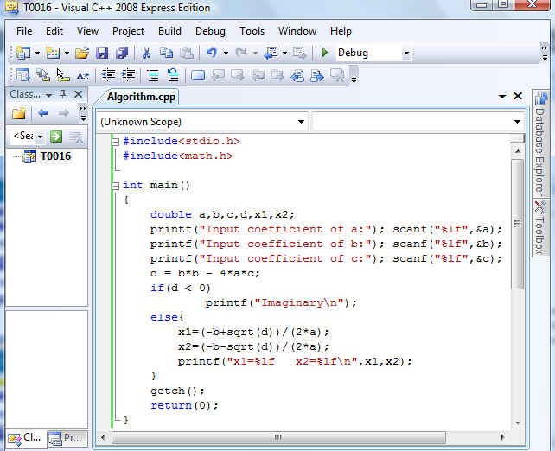
Algorithm Development Steps
Problem Definition
Model Development
Algorithm Design
Writing Code
COMPILE
Syntax Err
Executable code: => Run
Output Err
Documentation

Slide 11
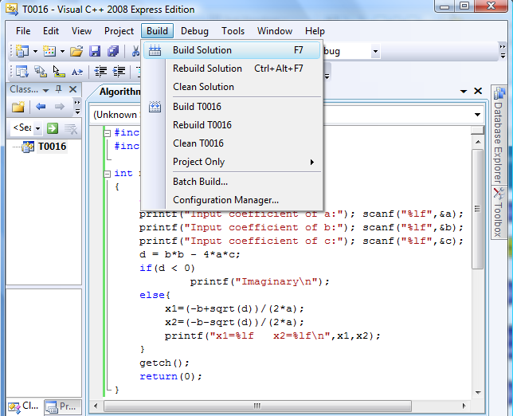
Algorithm Development Steps
Problem Definition
Model Development
Algorithm Design
Writing Code
COMPILE
Syntax Err
Executable code: => Run
Output Err
Documentation

Slide 12
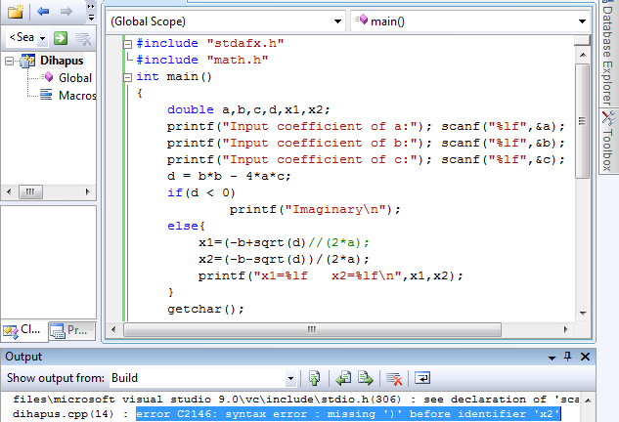
Algorithm Development Steps
Problem Definition
Model Development
Algorithm Design
Writing Code
COMPILE
Syntax Err
Executable code: => Run
Output Err
Documentation

Slide 13
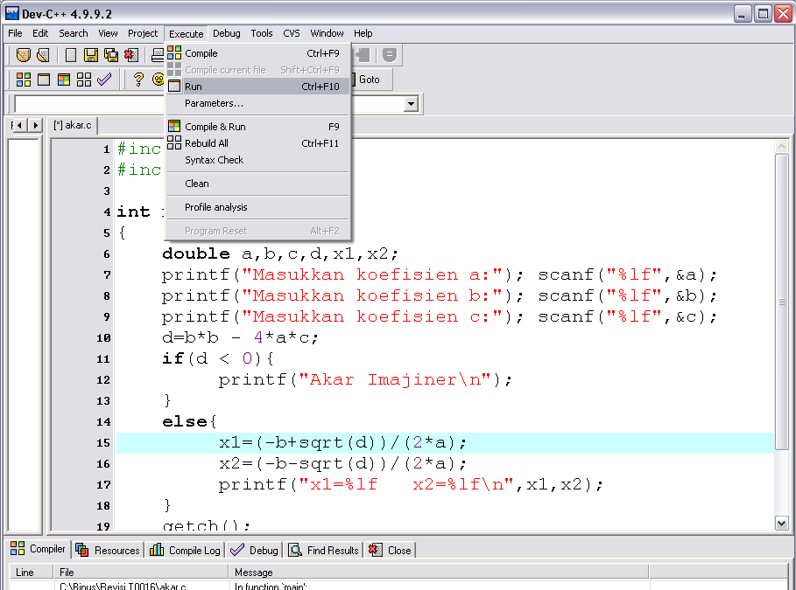
Algorithm Development Steps
Problem Definition
Model Development
Algorithm Design
Writing Code
COMPILE
Syntax Err
Executable code: => Run
Output Err
Documentation

Slide 14
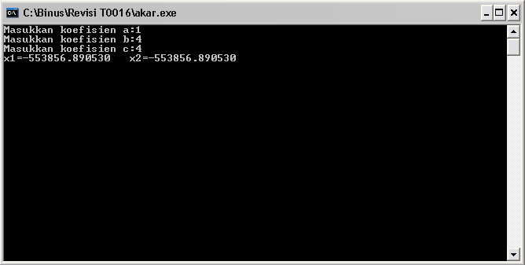
Algorithm Development Steps
Problem Definition
Model Development
Algorithm Design
Writing Code
COMPILE
Syntax Err
Executable code: => Run
Output Err
Documentation

Slide 15
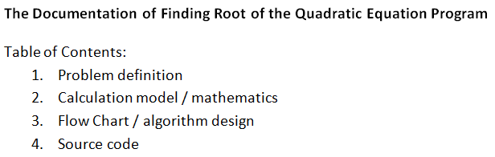
Algorithm Development Steps
Problem Definition
Model Development
Algorithm Design
Writing Code
COMPILE
Syntax Err
Executable code: => Run
Output Err
Documentation

Slide 16
Program Documentation
For your 1st semester, this concept is still unimportant
For your last semester, documentation is important in programming, especially in software engineering

Slide 17
Representing Algorithm
How to develop an algorithm?
We can use:
Writing
Structure English (narration) and Pseudo-code.
Drawing
Flow Chart

Slide 18
Pseudo-code
An artificial and informal language that helps you develop algorithms
Pseudo-code is similar to everyday English, convenient, and user friendly
Keywords are used to describe control structure
Example:
if, else, print, set, add, while, etc.

Slide 19
Pseudo-code
Basic Computer Operation:
Input
Output
Compute
Storing value to an identifier (Store)
Compare (Selection)
Repetition (Loop)

Slide 20
1. Input
Statements can be used when a computer receive information or input
Read, Get, Input or Key-In
Example:
Read bilangan
Get tax_code
Baca students_name

Slide 21
2. Output
Statements can be used when a computer displaying information or output:
Print, Write, Put, Output, or Display
Example:
Print “Bina Nusantara University”
Write “Algorithm and Programming”
Output Total
Display image

Slide 22
3. Compute
To do arithmetic calculation the following operators are used:
+ (add)
- (subtract)
* (multiply)
/ (divide)
() (scope)
Statement Compute, Calculate or Add also can be used
Example:
Add number to total
Total = Total + number

Slide 23
4. Storing Value to An Identifier (Store)
There are three ways of storing value into a variable:
Initializing value using statement Initialize or Set
Storing value as calculation result using =
To simply store a value into a variable using “Save” or Store
Example:
Set Counter to 0
Total = Price * Qty

Slide 24
5. Compare
One of the main operation in computing is comparing values and choosing options based on its result
Keyword used: IF, THEN and ELSE
Example:
IF Menu=‘1’ THEN
Discount = 0.1 * price
ELSE
Discount = 0.2 * price
ENDIF

Slide 25
6. Repetition (Looping)
To repeat an action/step, we use keyword DOWHILE and ENDDO
“tampilkan bilangan dari 0 sampai 9
Example:
NUMBER = 0
(selama number < 10)
DOWHILE number < 10
print number
number = number +1
ENDDO

Slide 26
Pseudo-code Example
Example : Algorithm using a calculator to sum values
Start
Set the calculator ON
Empty any values
Do
Input price
Push plus button (+)
while all prices have been input
print total price
turn OFF calculator
End

Slide 27
Pseudo-code Example
Example : Algorithm to count average grade of a class
Start
Set total to zero
Set grade counter to one
While grade counter is less than or equal to ten
Input the next grade
Add the grade into the total
Add one to the grade counter
Set the class average to the total divided by ten
Print the class average.
End

Slide 28
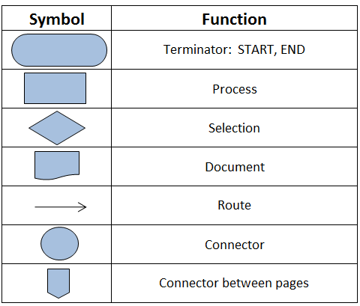
Flow Chart

Slide 29
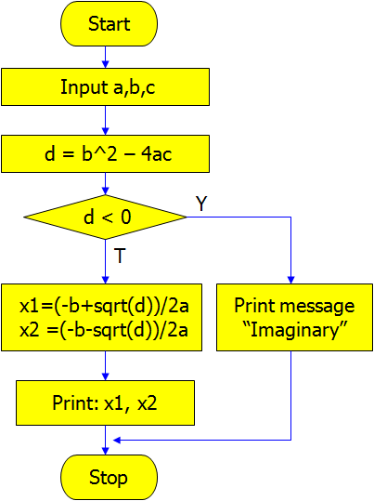
Flow Chart Example

Slide 30
Good Algorithm Practice
Having the right logical flow to solve the problem
Producing the correct output in a time efficient manner
Written using unambiguous structured language
Easy implementation into real programming language
All steps and operations are clearly defined and ended

Slide 31
Structure Theorem
Structure theorem which makes the computer programming possible using only three control structure, which are:
Sequence
Selection
Repetition

Slide 32
1. Sequence
Sequence is series of consecutive commands/statements
Commonly programming language has sequence of statements flowing from top of the program to its end

Slide 33
1. Sequence
Example :
Print “Number of students:”
Set total to 49
Print “Add new student:”
Read newStudent
total = total + newStudent
Print “Number of students:”
Print total
Description
Sequence of command is from the 1st line to the end of code. If newStudent input is 2 then total that later on printed out is 51

Slide 34
2. Selection
Selection control structure is structure that allow us to choose from several options of statement/command
The first statement will be executed if the condition is satisfied, if not then the else statement will be executed (if the other exist)

Slide 35
2. Selection
Example :
IF Day=1 THEN
Print “Monday”
ELSE
Print “Obviously not Monday”
Description
The word “Monday” will be printed out if Day’s value equal to 1, else it will print out the sentence “Obviously not Monday”.

Slide 36
3. Repetition
A number of statements/commands can be repeated several times using Repetition structure control
Statements/commands will be repeated while the looping condition is satisfied
(may use DOWHILE – ENDDO)

Slide 37
3. Repetition
Example :
Stars = 0
DOWHILE Stars < 5
Print Stars
Stars = Stars + 1
ENDDO
Description
At first Stars’ value equals to 0, after following the DOWHILE looping Stars’ value will be updated 5 times resulting:
0 1 2 3 4

Slide 38
Exercise
Using the Pseudo-code or english, create:
an algorithm to calculate a rectangle area!
an algorithm to change second into hour and minute unit!
an algorithm to decide whether an input number is an odd or even number!
an algorithm to calculate a circle area!
an algorithm to accept three numbers and find the max number!
Repeat no. 1 using Flow Chart

Slide 39
E
Input a,b,c
Jika b > a maka cek c > b, jika iya maka print c, jika tidak print b
a > b ? Cek c > a. Jika iya print c, jika tidak print a.

Slide 40
A.
Input panjang dan lebar
Luas = panjang * lebar
Print luas

Slide 41
D
Model math = luas lingkaran pi*r*r
Input r
Pi = 3,14 atau 22/7
Luas = Pi * r * r
Print Luas

Slide 42
B
Input detik
Menit = detik/60
Jam = detik/3600
Print menit
Print jam

Slide 43
C
Jika angka habis dibagi 2 = 0 hasilnya genap, kalau tidak ganjil
Input angka
Jika angka habis dibagi 2 = 0, print genap, kalau tidak (else) print ganjil

Slide 44
Summary
Algorithm is a procedure for solving a problem in terms of the actions to be executed
Algorithm development steps consists of: problem definition, model development, algorithm design, writing code, and documentation
We can use writing (Structure English and Pseudo-code) or drawing (Flow Chart) to represent algorithm
Basic Computer Operation: input, output, compute, store, compare, and repetition (loop)
Structure theorem are sequence, selection, and repetition

Slide 45
References
Tonny Gaddis. (2018). Starting Out with Programming Logic and Design. Pearson. New York
Pseudocode Examples: http://www.unf.edu/~broggio/cop2221/2221pseu.htm
Computer & Internet Help : Understanding Flowchart Symbols: http://www.youtube.com/watch?v=xLoL7tlJYws

Slide 46
END

